Slide 1

FRACTIONS

Slide 2

What does the picture represent?

Slide 3

What does the picture represent?

Slide 4
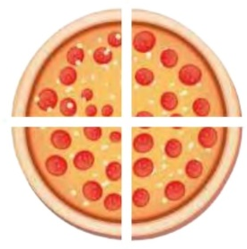
What does the picture represent?

Slide 5






2022-1-BG01-KA220-SCH-000085065
School subject: Mathematics
Students’Age: 9 years
Topic: Whole, Half And Quarter Fraction Representations
Credits: Antalya Directorate Of Education
All media are within the EU intellectual property law.
The European Commission’s support for this publication does not constitute an endorsement of the contents, which reflect the views only of the authors, and the Commission cannot be held responsible for any use which may be made of the information contained herein.

